Slide 1
AI-Enhanced Learning in Calculus Education
A Mixed-Methods Study of Recursive Understanding in Taylor Series Using Generative AI as a Learning Partner
Zheng Yang
Tuto Lopez Gonzalez
Todd Edwards
Sichuan University
Technology Educator Alliance
Miami University
Analysis scripts available at: https://github.com/OhioMathTeacher/TEA-Taylor-Series-Paper
Meeting Time: 9:00a Eastern US; 10:00p China; ZOOM link: here
Made with Genspark
Mde with Genspark
Notes:
1 minute: Overview of the study and intros of the authors

Slide 2
Research Question & Motivation (Zheng)
The Motivation: In Fall 2023, we worked with 4 students in a small pilot study using an AI agent to explore calculus topics and history. This study is a larger-scale follow-up. We were interested in understanding if we could use the agent to make calculus more meaningful and engaging for all students.
The Opportunity: Generative AI (genAI) offers adaptive, Socratic-style dialogue that can help students focus on (a) deep structural understanding of calculus and (b) meaningful application and culture in a manner (c) consistent with their learning preferences.
Core Question: "How does working with genAI as a learning partner shape the recursive development of students' understanding of calculus?"
Joint Mathematics Meetings • 2025
Notes:
Why did we do this? Mention previous study with early LLM (follow up study - bigger group and systematic use of LLM). We wanted to study how students develop understanding when interacting with an LLM

Slide 3
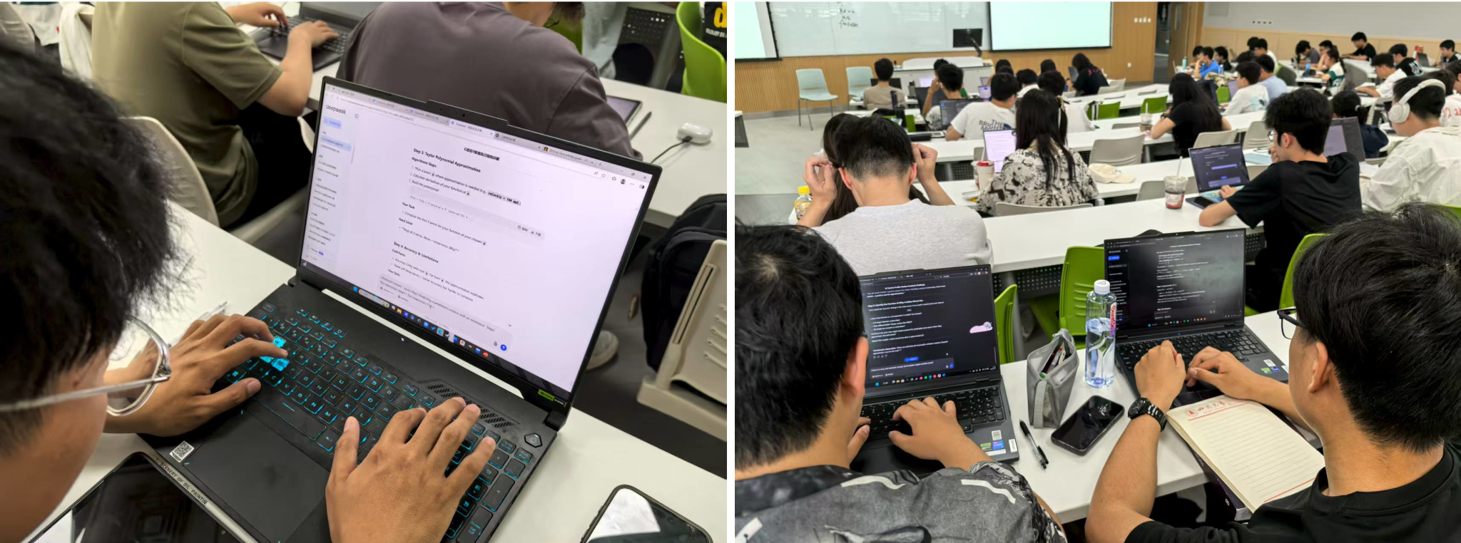
Study Context & Participants (Zheng)
The Setting: Several sections of second-semester Calculus at Sichuan University (n=144).
LLM Experience & Use Near-universal exposure: 93% had used DeepSeek; 52% ChatGPT
Not new to AI: 76% had ≥7 months of experience
Embedded in coursework: 98% had used LLMs in other university courses
Routine use: 93% used LLMs at least weekly (53% several times/week)
Use Patterns & Context
Primarily individual work: 69% worked alone
How LLMs were used:
Understanding new topics (88%)
Checking work (86%)
Searching for information (86%)
Faculty beliefs about AI are mixed:
38% encourage AI use
33% allow but do not encourage
10% discourage
Joint Mathematics Meetings • 2025

Slide 4
Student Assignment & Agent Design (Tuto)
I
Personality Profiling
Student defines preferred learning dynamics:
Tone (humorous vs formal)
Feedback style (direct vs Socratic)
Preferred challenge level
II
Adaptive Persona Creation
GenAI constructs a tailored tutor persona (aka "agent") (invisible to student) designed to optimize engagement and trust.
III
Five-Step Recursive Task
Context: Real-world problem framing
Function: Identify mathematical model
Approximate: Construct Taylor Polynomial
Analysis: Accuracy, limits, error bounds
Reflection: Metacognitive review
Students identified a mathematical model, constructed Taylor polynomials, analyzed error bounds, and conducted a metacognitive reflection.
Joint Mathematics Meetings • 2025
AI-Enhanced Learning in Calculus Education
Notes:
Focus on demoing the agent. We'll distribute a paper copy of the prompt as a one-pager for folks to look at during the demo, but not focus so much on how to create the agent. (Another talk for another day!)

Slide 5
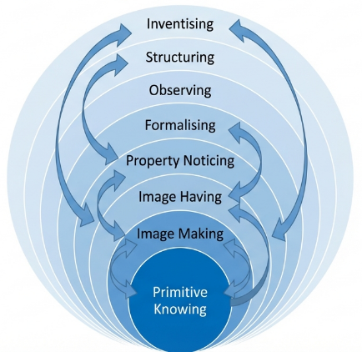
Theoretical Framework (Tuto)
Pirie-Kieren Theory of Mathematical Understanding
Layered & Recursive Nature
Mathematical understanding is not linear but dynamic and recursive. Learners move through nested layers of understanding, building sophistication over time rather than in a straight line.
Eight Nested Levels
The framework defines eight distinct levels ranging from concrete engagement ("Primitive Doing") to abstract invention ("Inventising"). Each outer layer encompasses and requires the inner layers.
The Concept of "Folding Back"
A critical mechanism where learners return to inner layers to reconstruct earlier understanding when facing new challenges. This recursive movement strengthens conceptual foundations.
Alignment with Generative AI
GenAI acts as a responsive partner that can trigger folding back through adaptive prompts, dynamic visualizations, and guided reflection, supporting movement between layers.
Outer Levels (Abstraction)
Inner Levels (Concrete)
Joint Mathematics Meetings • 2025
Theoretical Framework

Slide 6

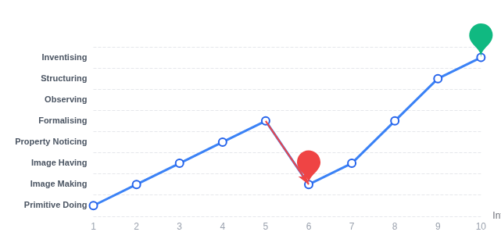


Sample Case Study (Tuto & Todd)
Participant ID: P23-G10-S5
Deep Conceptual Engagement & Recursive Learning
Learning Trajectory
Recursive Pathway Analysis (PK-WAP)
Context: Real-time fluid dynamics modeling.
Conflict: Student realized direct computation was too slow for real-time use.
Recursion: Folded back from Formalising to Image Making to reconceptualize the problem, then advanced to Structuring.
Outcome: Reached Inventising by evaluating accuracy vs. efficiency trade-offs.
"Let's test a piecewise approximation and check error bounds to see if we can optimize the compute time."
Conceptual Layer
Learning Path
Folding Back
STUDENT MOVE: INVENTISING

Slide 7



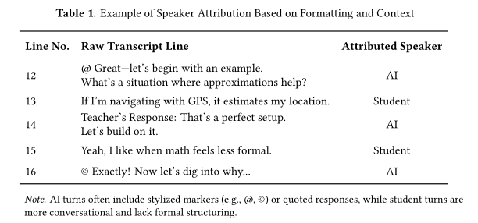
Methodology (GenAI Assisted Research) (Todd)
Design-Based Research Grounded in the Pirie-Kieren Framework
The Workflow
Data Collection Sources
Approach: Used VS Code + GitHub CoPilot to automate qualitative research tasks.
127 Transcripts
Complete student-AI interaction logs (PDF/DOCX)
Post-Activity Survey
n=144 responses (all attendees)
Phase I (Transcript Screening)
Goal: Estimate engagement levels via word counts & attribution
Semi-Automated Pipeline: Python-based parsing with OCR to process 127 transcripts.
Speaker Attribution: Algorithm blending formatting cues (@ symbols) with heuristics.
Metrics Calculation: Word counts, student talk percentages, and interaction density.
GS Interview
Semi-structured interview with Graduate Student
Phase II (Qualitative): Developed the PK-WAP (Pirie–Kieren Work Analysis Protocol) to code for recursive understanding in 30 anchor transcripts (10 high word count percentages; 10 low percentages; 10 noteworthy cases).
Joint Mathematics Meetings • 2025

Slide 8
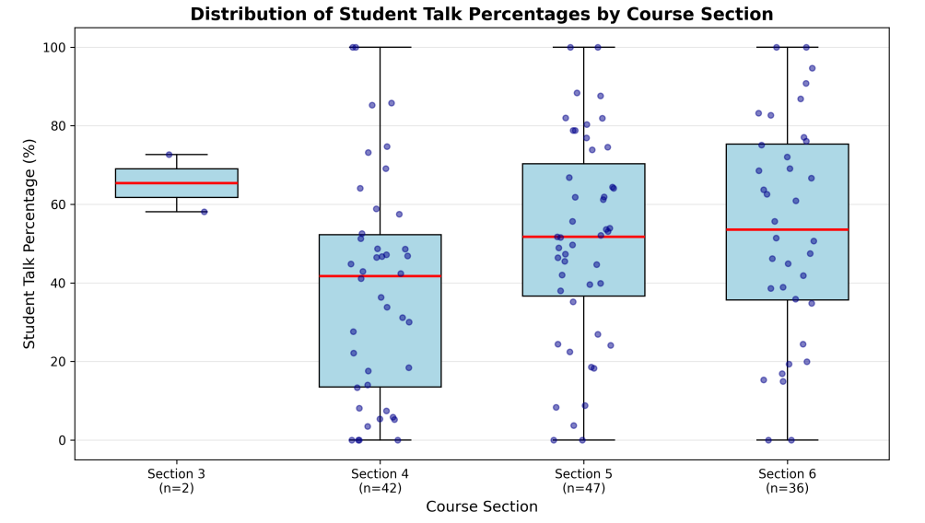
Key Findings: Engagement Patterns (Todd)
What do you notice? What do you wonder?
Notes:
Todd Edit What is Folding Back Cycles? Why are the numbers the same?

Slide 9
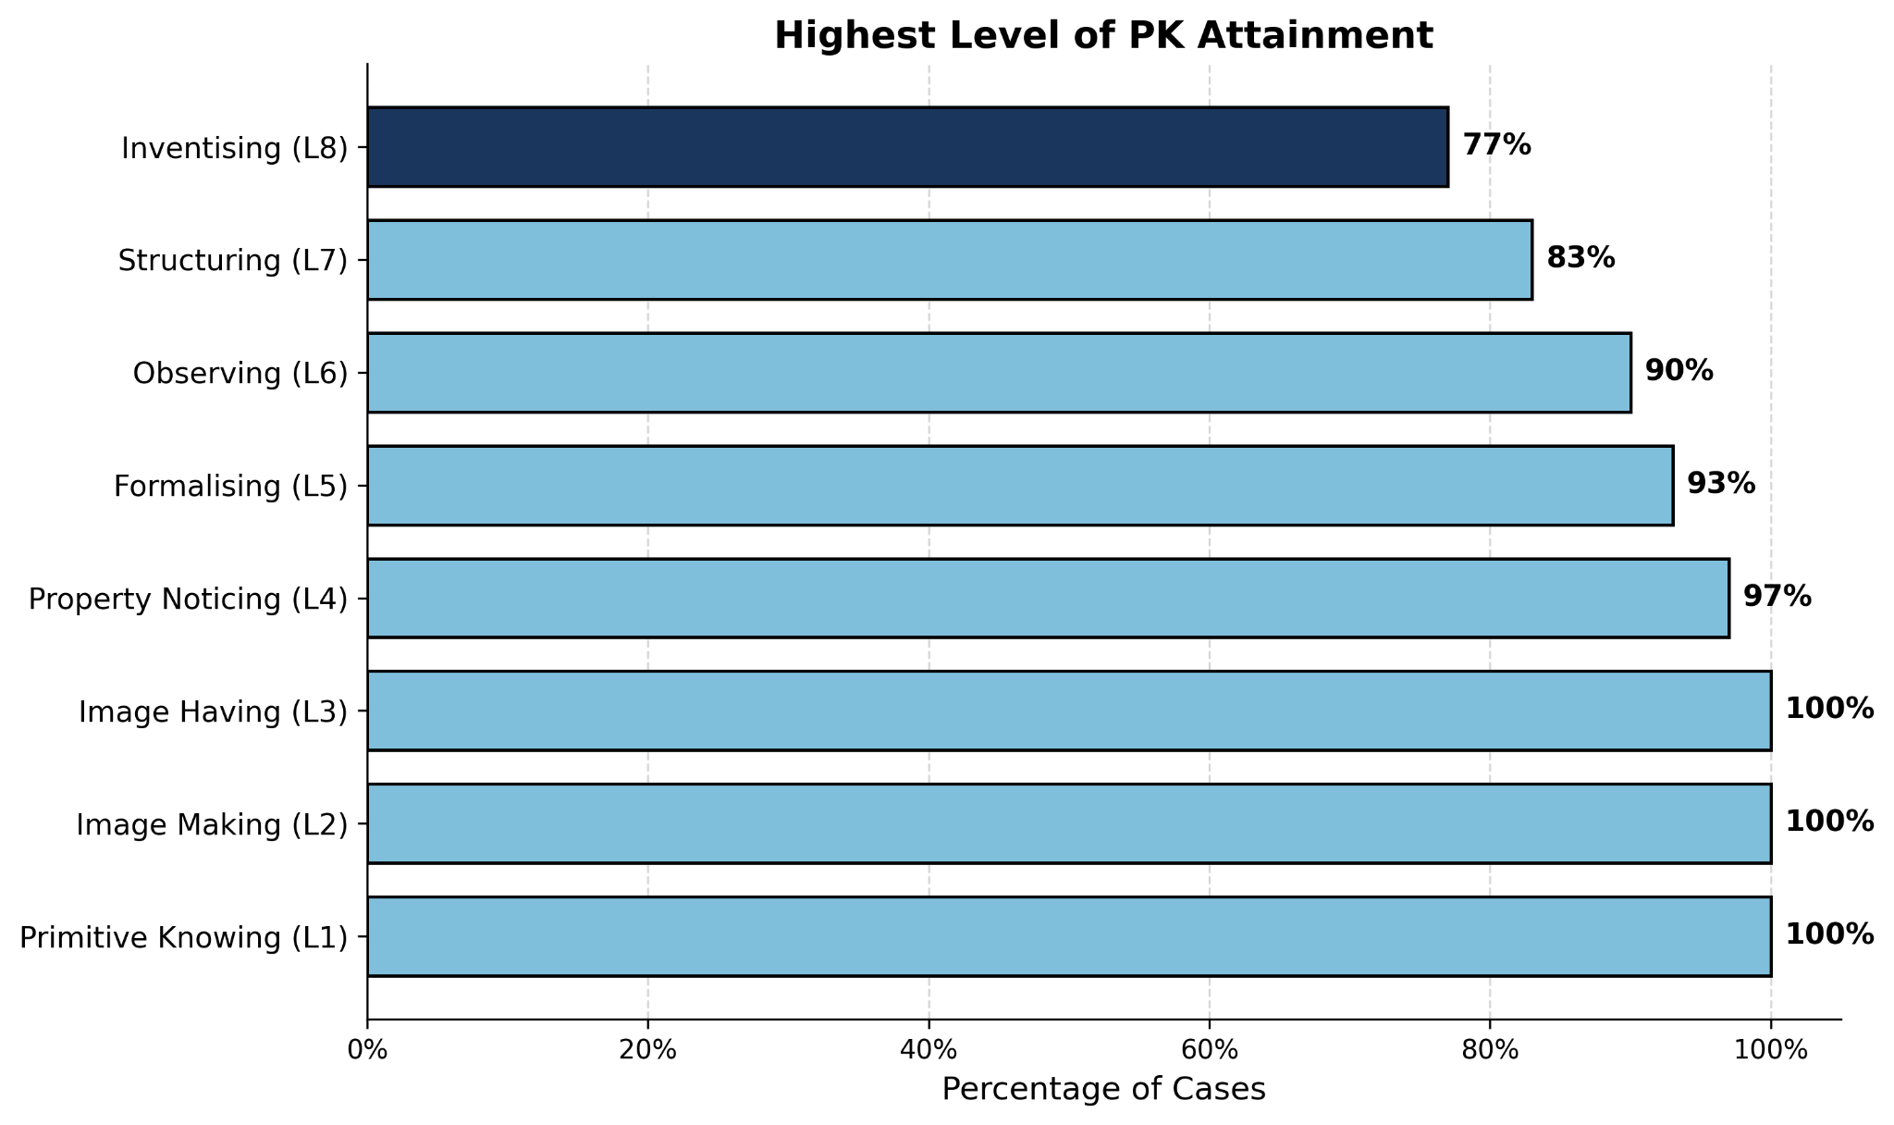
Key Findings: Highest Level of PK Attainment (Todd)
What do you notice? What do you wonder?
Notes:
Todd Edit What is Folding Back Cycles? Why are the numbers the same?

Slide 10




Implications & Conclusions (Todd)
Emergent Patterns from Transcript Analysis
1
Recursive Learning as Normative
"Folding back" was not an exception but the norm. Students routinely revisited earlier layers (Image Making/Property Noticing) to resolve confusion before advancing.
Recursion
Context
2
Contextualization Drives Inventising
Authentic applications (e.g., satellite orbits, wind turbines) catalyzed high-level reasoning. Real-world constraints pushed students to modify standard models.
Agency
Adaptivity
3
Balancing Agency & AI Scaffolding
Effective learning required a delicate balance. Students thrived when they took initiative to pose problems rather than passively following AI prompts.
Core Insight
4
Missed Pedagogical Opportunities
Instances where AI over-prompted, withheld answers too long, or dominated the dialogue, reducing student ownership and causing frustration.
"The synergy of recursive inquiry and authentic context—mediated by adaptive AI—created the conditions for deep conceptual engagement."
5
Adaptivity via Personalization
Persona profiling proved effective. Tailored AI tones (e.g., Socratic, direct, humorous) matched student preferences, sustaining engagement.

Slide 11
Questions? Comments? Concerns? Feedback? (Zheng)
We enjoyed spending time with you today!
Thank you for spending some time with us.
Feel free to contact us:
Zheng Yang: zhengyang2018@scu.edu.cn
Todd Edwards: edwardm2@miamioh.edu
Tuto Lopez Gonzalez: caalopezgo@gmail.com
Check out materials related to this study, including draft manuscripts, analysis tools, and more at https://github.com/OhioMathTeacher/TEA-Taylor-Series-Paper

